Slide 1

Deep Learning Toolkit
1378 Mod 02

Slide 2
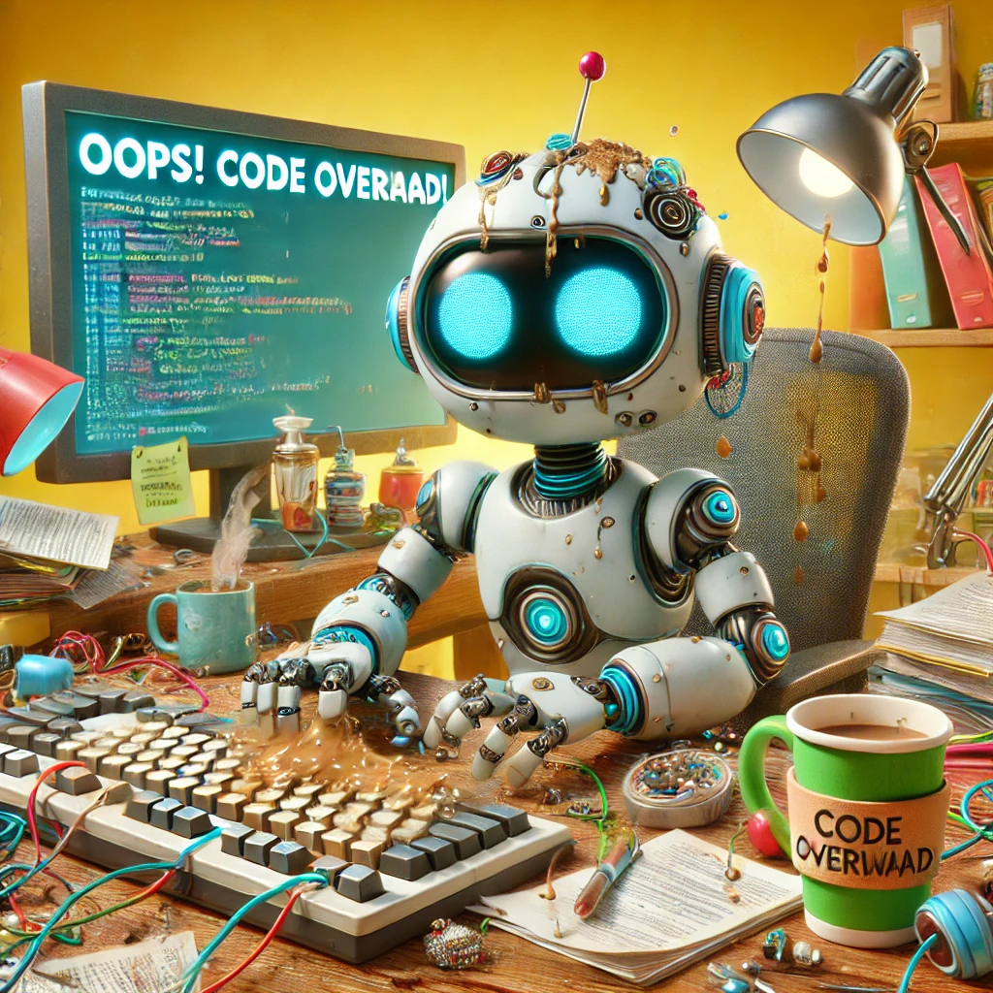
Programing Languages
Industry Standard
Python: Most popular language for ML/DL.
Other Languages
Wolfram: Incorporates ML suite of functionalities
Julia: Emerging language with focus on performance.
R: Used primarily for statistics and data analysis.

Slide 3
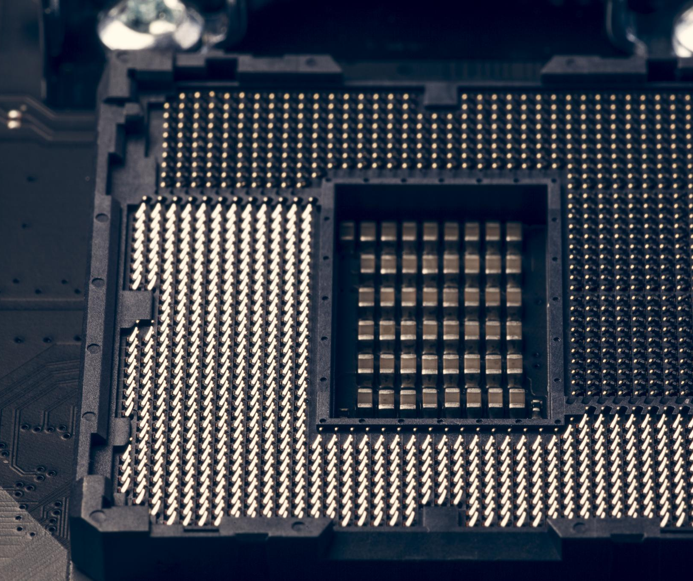
Creating the Perfect Environment for Deep Learning
Select a high-performance local machine with powerful GPUs.
Consider cloud-based services for scalable computational resources.
Utilise notebook environments for interactive coding and experimentation.
Notes:
Setting up the environment for deep learning involves choosing between local machines, cloud services, and notebook environments. Local machines should feature powerful GPUs for efficient processing. Alternatively, cloud services provide scalable solutions to accommodate varying workloads. Additionally, using notebook environments like Jupyter Notebook allows for easy experimentation and visualization of results.

Slide 4

Setting up The Environment

Slide 5
1. Local Machine Setup
Hardware Requirements:
High-performance GPU (e.g., NVIDIA RTX 30 series or better).
At least 16GB of RAM (32GB recommended for large models).
SSD storage for faster data access.
Software Requirements:
Python (latest stable version).
Deep learning frameworks like TensorFlow, PyTorch, or JAX.
Tools: Jupyter Notebook or Lab, Visual Studio Code, Conda.
Advantages:
Full control over the environment.
One-time hardware cost (no recurring fees).
Disadvantages:
Limited scalability and slower training for large datasets.

Slide 6
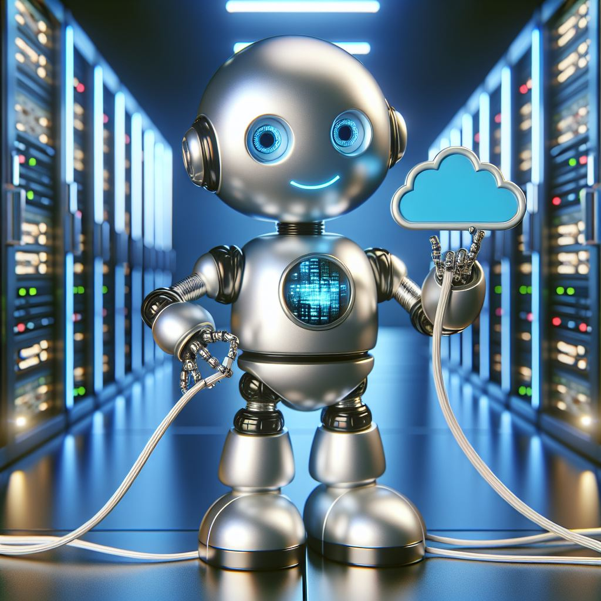
2. Cloud Setup
Popular Providers:
AWS (Amazon SageMaker, EC2 with GPUs).
Google Cloud (Vertex AI, Colab Pro).
Microsoft Azure (Machine Learning Studio).
Tools:
Google Colab, Jupyter Notebook, or Jupyter Lab.
Advantages:
On-demand scalability with high-performance GPUs and TPUs.
Access to pre-configured environments for faster setup.
Collaboration-friendly with shared notebooks and managed services.
Disadvantages:
Recurring costs based on usage.
Potential latency in data transfer.

Slide 7
3. Local vs Cloud
Choosing the Right Environment
Use Local Machine if:
Working with small to medium datasets.
Hardware resources meet model requirements.
Budget constraints favor one-time costs.
Use Cloud if:
Large-scale training or deployment is required.
Collaboration and remote access are priorities.
Rapid scaling for experiments is nee

Slide 8
4. Hybrid Approach
Combine the best of both worlds:
Develop locally, then train at scale on the cloud.
Use cloud storage for datasets while leveraging local computation for prototyping.
Key Tip: Match your project requirements and budget to the setup to maximize efficiency and minimize costs.

Slide 9

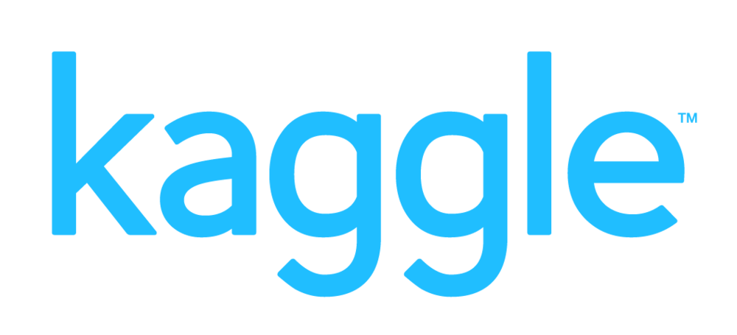
Platforms for Practical Learning
Kaggle: Offers datasets, interactive notebooks, and competitions for hands-on machine learning and deep learning practice.
GitHub: Hosts course materials, example code, and provides version control for collaborative and professional project management.
Hugging Face: Provides state-of-the-art tools, pretrained models, and a community hub for experimenting with and deploying machine learning models.
Notes:
Kaggle: A robust platform for hands-on learning with access to public datasets, interactive kernels (notebooks), and competitions. It enables students to practice machine learning and deep learning skills in a collaborative environment, with tutorials for both beginners and advanced users.
GitHub: An essential tool for hosting course materials, sharing example code, and managing version control for student projects. It facilitates collaboration and allows students to showcase their work to potential employers.
Hugging Face: A cutting-edge platform offering open-source tools and pretrained models for Natural Language Processing (NLP), computer vision, and more. Hugging Face is ideal for experimenting with state-of-the-art models and deploying them in real-world applications. It also provides a community hub for sharing and discovering machine learning models and datasets.

Slide 10

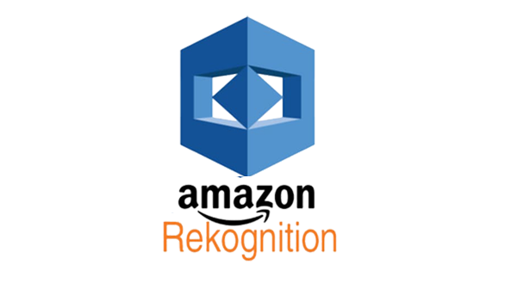
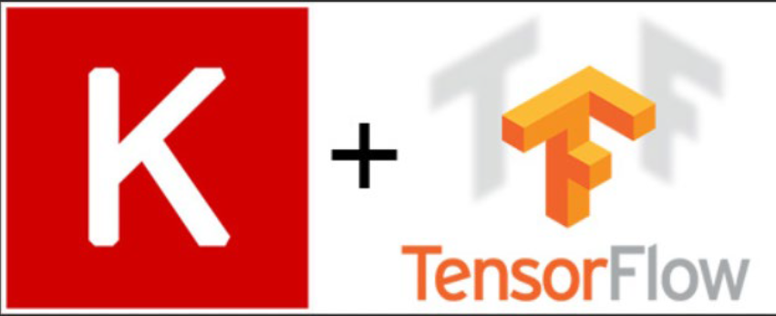
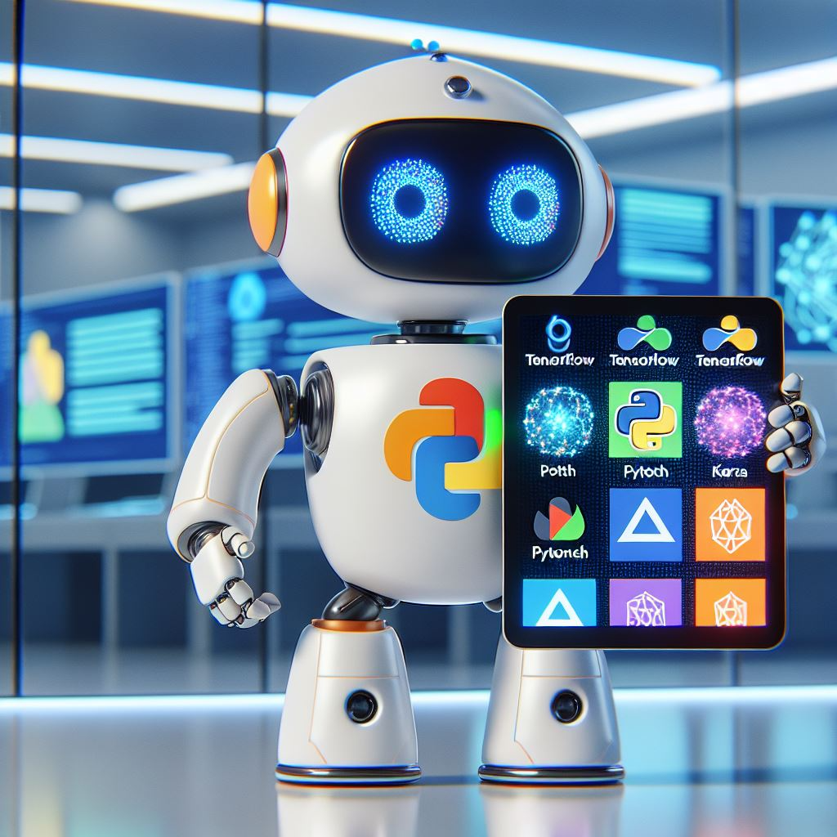

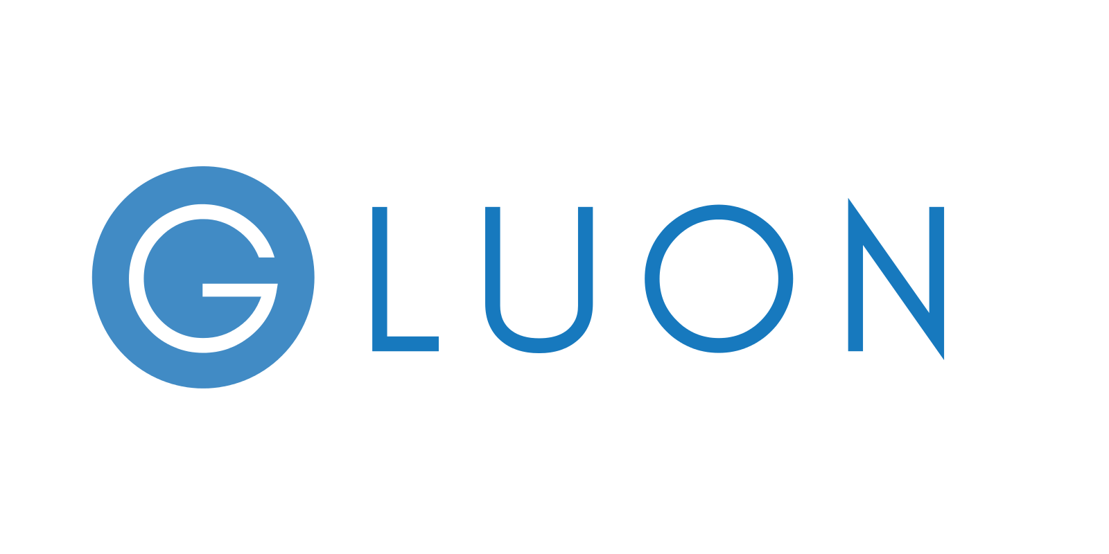
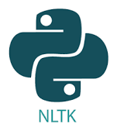
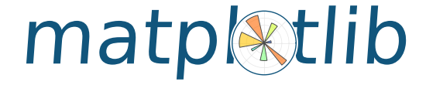
Libraries & Frameworks
Notes:
As we begin exploring the landscape of deep learning libraries and frameworks, it's important to understand that these tools form the foundation of modern AI development. Think of these frameworks as different languages that allow us to communicate with computers to build AI systems. Each has evolved to serve specific needs in the field, and understanding their roles will help you make informed decisions in your future projects. The logos you see represent the major players in this ecosystem, but today's focus will be on the most relevant ones for your learning journey.

Slide 11
Core Deep Learning Frameworks
"Modern Deep Learning Framework Landscape
Primary Frameworks:
PyTorch: Research & Education Focused
TensorFlow/Keras: Industry & Deployment
JAX: Advanced Research & Performance
Each serves distinct needs in the AI ecosystem"

Slide 12
PyTorch: The Researcher's Choice
Intuitive Python Integration
Dynamic Computation Graphs
Rich Research Ecosystem
Strong Community Support
Industry Users: Meta, Microsoft, OpenAI, Tesla"
Notes:
PyTorch has emerged as the preferred framework in research and education for several compelling reasons. Its design philosophy prioritizes Python integration, making it feel natural for anyone familiar with Python programming. The dynamic computation graphs allow for flexible model design and easier debugging - imagine being able to pause and inspect your model at any point, just like traditional Python debugging. This framework has gained significant traction because it makes complex deep learning concepts more approachable. When students ask why we're starting with PyTorch, I explain that it provides the clearest path to understanding deep learning fundamentals while still being powerful enough for advanced applications.

Slide 13
TensorFlow & Keras: Production Power
Enterprise-Grade Deployment
Mobile & Edge Computing Support
Comprehensive Production Tools
Strong Corporate Backing
Industry Users: Google, Intel, Apple, Twitter
Notes:
TensorFlow, along with Keras, represents the industrial strength option in deep learning. Think of it as the difference between learning to cook at home versus running a professional kitchen - both are valid, but they serve different needs. TensorFlow excels in deployment scenarios, offering robust tools for taking models from development to production. The framework provides extensive support for mobile and edge devices, crucial for real-world applications. While we won't focus heavily on TensorFlow initially, understanding its role in the ecosystem is vital for your career development. Many of our students who move into industry roles eventually work with TensorFlow, particularly when dealing with production deployments.

Slide 14
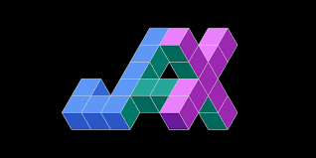
JAX: The New Frontier
JAX: High-Performance Computing
Automatic Differentiation
Hardware Acceleration
Functional Programming Approach
Advanced Research Applications
Users: DeepMind, Google Research, Academic Labs
Notes:
JAX represents the cutting edge of deep learning frameworks. It's gaining popularity because it combines the best of modern computing practices with deep learning needs. The framework excels in scenarios requiring high performance and mathematical precision. While you might not use JAX immediately in your career, understanding its growing importance helps you stay ahead of industry trends. JAX's success lies in its ability to automatically optimize code for modern hardware while maintaining a clean, functional programming approach. Think of it as a high-performance sports car - not your first vehicle, but something you might aspire to master as you advance in the field.

Slide 15
Framework Comparison
PyTorch
Learning Curve: Gentle
Best For: Learning, Research, Prototyping
Community: Large academic & research focus
Debugging: Excellent, Python-like experience
TensorFlow
Learning Curve: Moderate
Best For: Production, Enterprise deployment
Community: Large industry focus
Debugging: Good, structured approach
JAX
Learning Curve: Steep
Best For: High-performance computing, Research
Community: Growing, research-focused
Debugging: Requires more expertise"
Notes:
Understanding when to use each framework is crucial for your development as an AI practitioner. Let's use an analogy: Think of PyTorch as learning to drive with a manual transmission car - it gives you full control and helps you understand what's happening under the hood. TensorFlow is like an automatic transmission with advanced features - more structured and production-ready, but possibly hiding some complexity. JAX would be like a high-performance racing vehicle - powerful but requiring specialized knowledge to operate effectively.
The reason we focus on PyTorch in this program is that it provides the best foundation for understanding deep learning concepts. The skills you learn with PyTorch will transfer well to other frameworks later in your career. When students ask about job requirements mentioning TensorFlow, I remind them that understanding the core concepts is more important than specific framework knowledge at this stage.
PyTorch's advantages stem from several key design decisions that make it particularly well-suited for these contexts:
Dynamic Computation Graphs (Define by Run): PyTorch builds computation graphs dynamically during runtime, which means the graphs are constructed as your code executes. Think of it like writing a story - you can change the plot as you write, rather than having to outline everything in advance. This has profound implications for learning and research:
Debugging becomes more intuitive because you can use standard Python debugging tools
You can modify your network architecture on the fly
The behavior of your model is immediately visible at each step
Code execution follows a logical, line-by-line flow
Python Integration: PyTorch feels like a natural extension of Python rather than a separate framework. This integration manifests in several ways:
Native Python Data Structures: It works seamlessly with Python lists, dictionaries, and other standard types
Python Control Flow: You can use regular Python if statements, loops, and functions without special syntax
Python Error Messages: When something goes wrong, you get standard Python tracebacks that are easier to understand
Consider this example of the difference in approach:
python
Copy
# PyTorch - Feels like regular Python for batch in data: if condition: output = model(batch) else: output = alternative_model(batch)
Versus a static graph approach where such dynamic behavior would need special handling.
Research-Friendly Features: PyTorch provides several features that make it ideal for research:
Easy Model Modification: You can change any part of your model between training iterations
Custom Layer Creation: Writing new layer types is straightforward and follows standard Python class patterns
Gradient Access: You have direct access to gradients and can modify them as needed
Memory Management: Direct control over when tensors are created and destroyed
Community and Ecosystem: The research-friendly nature of PyTorch has created a virtuous cycle:
Researchers choose PyTorch for its flexibility
More research papers include PyTorch implementations
More research tools are developed for PyTorch
This makes PyTorch even more attractive for new researchers
For Prototyping: The combination of these features makes PyTorch excellent for prototyping:
Fast Iteration: You can quickly test new ideas without rebuilding computation graphs
Interactive Development: Works well in Jupyter notebooks for experimental development
Clear Feedback: Immediate visibility into what's happening in your model
Extensive Pre-built Components: Large collection of pre-implemented layers and models
Teaching Perspective: From an educational standpoint, PyTorch's design aligns with how humans naturally learn:
Immediate Feedback: Students can see results immediately
Clear Connection: The relationship between code and outcomes is transparent
Natural Progression: Concepts build on familiar Python programming patterns
Error Understanding: When mistakes happen, they're easier to identify and fix
Consider this analogy: If learning deep learning is like learning to cook, PyTorch is like cooking in a kitchen where you can taste your food at any point, adjust ingredients as you go, and see exactly what's happening in your pot. Other frameworks might be like following a precise recipe where you can only taste the final result.
This combination of features creates an environment where:
Beginners can focus on understanding concepts rather than framework specifics
Researchers can quickly implement and test new ideas
Prototypes can be developed and modified rapidly
Code remains readable and maintainable
This is why, despite some other frameworks potentially offering better production deployment features, PyTorch has become the go-to choice for learning, research, and prototyping in deep learning.

Slide 16
Supporting Ecosystem
Data Handling & Processing
NumPy: Numerical computing foundation
Pandas: Data manipulation & analysis
Scikit-learn: Traditional ML tools
Visualization & Monitoring
Matplotlib/Plotly: Data visualization
TensorBoard: Training monitoring
Weights & Biases: Experiment tracking
Model Development
Hugging Face: Pre-trained models
torchvision/tensorflow.keras: Domain-specific tools
Notes:
The deep learning ecosystem extends beyond just the main frameworks. Think of these supporting libraries as your toolkit - just as a carpenter needs more than just a hammer, you'll need more than just a deep learning framework. NumPy forms the foundation, providing the mathematical operations that all frameworks build upon. Pandas helps you prepare and manipulate your data, while visualization tools help you understand what's happening in your models.
A common question from students is why we need so many different libraries. I explain that each tool is optimized for specific tasks - trying to do everything with just one tool would be like trying to build a house with only a hammer. Understanding how these tools work together is crucial for effective deep learning development.

Slide 17
Real-World Decision Making
Academic/Research Projects
Focus on experimentation & flexibility
Priority: Easy implementation of new ideas
Recommendation: PyTorch or JAX
Industry Applications
Focus on deployment & scalability
Priority: Production stability & performance
Recommendation: TensorFlow or PyTorch
Learning/Development
Focus on understanding fundamentals
Priority: Clear code & good documentation
Recommendation: Start with PyTorch"

Slide 18
Key Takeaways
Framework choice depends on your goals
Start with PyTorch for learning
Understanding concepts > specific tools
Consider the broader ecosystem
Prepare for continuous learning
Notes:
As we conclude this overview of deep learning frameworks and tools, remember that your choice of framework is less important than understanding the fundamental concepts. Think of frameworks as different languages - while each has its strengths, the underlying principles of communication remain the same. In the next module, we'll begin diving into these fundamentals, starting with the basic building blocks of neural networks.
You might be feeling overwhelmed by the number of tools and options available. This is normal and expected. Remember that no one uses all these tools at once, and you'll gradually become comfortable with them as you progress through your learning journey. Focus first on understanding the basics with PyTorch, and the rest will follow naturally.
Any questions about the frameworks or tools we've discussed today? Understanding this landscape is crucial for your development as AI practitioners, so please feel free to ask for clarification on any points.

